Slide 1

Housing Price Prediction
Final Project Presentation
AML 3104 - Neural Networks and Deep Learning

Slide 2

Members
Ajomon Jose
Ashna Viji Alex
Anisha Susan Mathew
Varun Kashyab Hariharaputhran
Group : 5

Slide 3

Introduction
predicting house price in King County, USA.
Sourced from Kaggle, includes various features related to houses. The goal is to classify predict house price based on different features of a house like square feet, area, number of bedrooms, etc.
Dataset: https://www.kaggle.com/code/burhanykiyakoglu/predicting-house-prices/notebook

Slide 4

Data set
No. of Record – 21000
No. of Features - 21
Price
Bedrooms
Bathrooms
Sqft_living
Sqft _lot
Floors
Waterfront
View
Condition
Id
Sqft_basement
Year_built
Year_renovated
Lattitude
Longitude
Sqft_living15
Sqft_lot15
Grade
Sqft_above
Zipcode

Slide 5

Data Cleaning
Removal of Irrelevant feature | Checking for Null values | Outlier Detection | Data Transformation
Removed Id, Zipcode and date | Zero null values Zero Duplicates | Use Box plot and Interquartile Range 1121 records were found as outliers | Changing signs like – into +. Changing datatype.
After Data cleaning, No. of records = 19,879

Slide 6
Feature Engineering
Transformation of Year_built and Year_renovated into the category of ‘Old’.
Finding correlation matrix using the existing features did not provide satisfactory results.
Feature Interactions : living_lot = sqft_living/ sqft_lot
living15_lot15 = sqft_living15/ sqft_lot15
con_grade = (condition/5)*(grade/13)
Dropping appropriate columns, new Dataset has 14 features

Slide 7
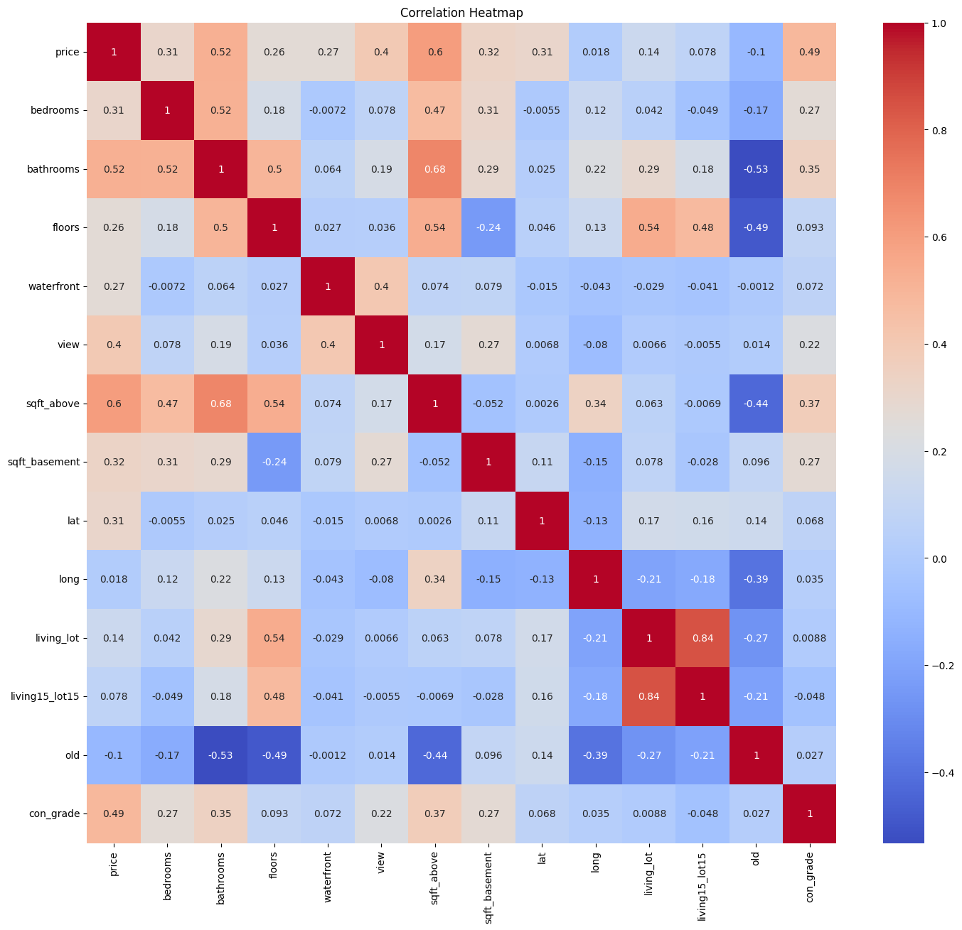
Visualization
Heat Map after Transformations

Slide 8
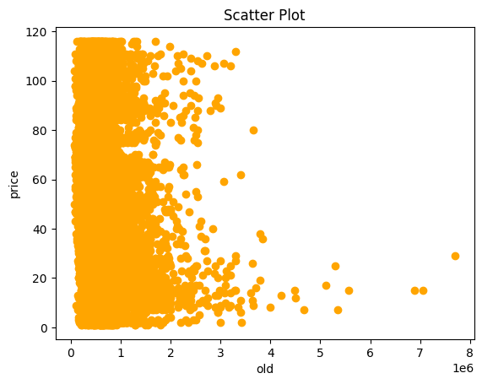
Scatter Plot
Between Age and Price
Variable Old has negative correlation with Price
As age of the house increases price of the house decreases and vice versa

Slide 9
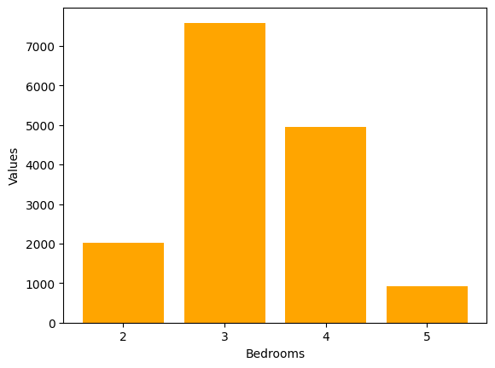
Bar Graph
Bedrooms

Slide 10
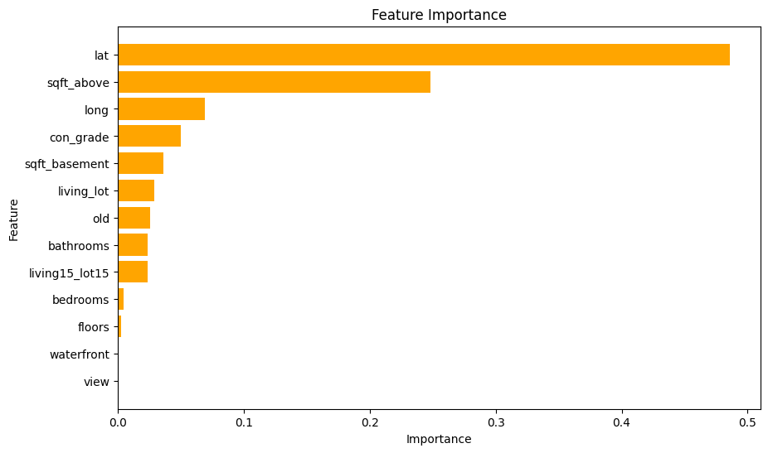
Feature Importance

Slide 11

Finding the Best Model
01
02
03
Linear Regression
Decision Tree
Random Forest
Assumes linear relationship between dependent variable and independent variables.
Split the data into branches, that can capture nonlinear relationships in the data
Construct multiple decision trees and merge their result.
Split and Standardize the data

Slide 12
Model Training using Linear Regression
Linear Regressor CV RMSE : 120401.96456486163, 115387.73803984754, 113816.69197213936, 118087.0678649692, 120223.58169826161
After Hyperparameter tuning using Ridge Regression
Best RMSE : 114281.7806
R2 : 0.6303
Adj R2 : 0.6287

Slide 13

Decision Tree Regression
Decision Tree Regressor CV RMSE: 104729.83363770414, 105629.6571570201, 98102.06461478004, 105458.30837435935, 108563.86464832787
After Hyperparameter tuning using Grid Search:
Best RMSE : 83,987.31
R2 : 0.8003
Adj R2 : 0.7994

Slide 14

Random Forest Regressor
Cross-validated R2 scores : 0.84301536 0.84112348 0.8483632 0.84444288 0.84273448
Mean cross-validated R2 : 0.843935879024176
RMSE : 72975.593
Adj R2 : 0.8432

Slide 15
Best Model
 | RMSE | R2 | Adj R2
Linear Regression | W114281.7806 rite here | W0.6303 rite here | Write0.6287 here
Decision Tree | 83,987.31 | 0.8003 | 0.7994
Random Forest | 72975.593 | 0.8439 | 0.8432
Decided to go with Random Forest

Slide 16
Thank You !
Click here for the deployment video

